Slide 1
2024
High Level Design
BUDGET SALES ANALYSIS
AMAN PRATAP SINGH

Slide 2
Document Version Control
1 High Level Design
Date Issued | Version | Description | Author
01-03-2024 | 1.0 | First version of Complete HLD | Aman Pratap Singh

Slide 3
2 High Level Design
Table of Contents
1. Introduction ......................................................................................... 4
1.1 Why this High-Level Design Document? ........................ 4 1.2 Scope ................................................................................................. 5 2. General Description .......................................................................... 6
Product perspective and problem statement............... 6 2.2 Tools used ....................................................................................... 7 3. Design Details...................................................................................... 8 3.1 Functional Architecture ........................................................... 8 3.2 How BI Works ............................................................................... 9 3.3 Optimization................................................................................10
Your data strategy drives performance......................10
Reduce the marks (data points) in your view..........10
Limit your filters by number and type ........................10
Optimize and materialize your calculations.............11
4. KPI ...........................................................................................................13
4.1 KPIs (Key Performance Indicators .................................13
5. Deployment ........................................................................................15
5.1 Power BI Report......................................................................16

Slide 4
3 High Level Design
Abstract
The growth of resell business in most populated cities are increasing and market competitions are also high. The dataset is one of the historical sales of a company named Adventure Works which has records for 3 years. Good data driven systems for analyzing sales can improve the performance of the company and generate more ROI to the stakeholders.

Slide 5
4 High Level Design
Introduction
Why this High-Level Design Document?
The purpose of this High-Level Design (HLD) Document is to add the necessary detail to the current project description to represent a suitable model for coding.
This document is also intended to help detect contradictions prior to coding, and can be used as a reference manual for how the modules interact at a high level.
The HLD will:
Present all of the design aspects and define them in detail
Describe the user interface being implemented
Describe the hardware and software interfaces
Describe the performance requirements
Include design features and the architecture of the project
List and describe the non-functional attributes like:
Security
Reliability
Maintainability
Portability
Reusability
Application compatibility
Resource utilization
Serviceability

Slide 6
5 High Level Design
1.2 Scope
The HLD documentation presents the structure of the system, such as the database architecture, application architecture (layers), application flow (Navigation), and technology architecture. The HLD uses non-technical to mildly-technical terms which should be understandable to the administrators of the system.

Slide 7
6 High Level Design
General Description
Product perspective and problem statement
The goal of this project is to analysis sales and evaluate the performance of the sales team against its target. It provides insights about the top performing and underperforming products/services, the problems faced to meet the target and market opportunities and sales activities that generate revenue.

Slide 8
























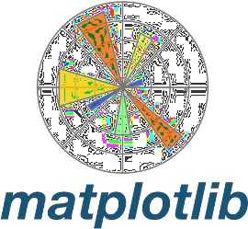
7 High Level Design
2.2 Tools used
Business Intelligence tools and libraries works such as NumPy, Pandas, Seaborn, Matplotlib, MS-Excel, MS-Power BI, Jupyter Notebook and Python Programming Language are used to
build the whole framework

Slide 9





8 High Level Design
Design Details
Functional Architecture
STEP 1 | STEP 2 | STEP 3 | STEP 4 | STEP 5
Data from source system is integrated and loaded into a data warehouse of another analytics repository | Data sets are organised into analytics data models or OLAP cubes to prepare them for analysis | BI analysts, other analytics professionals and business users run analytical queries against the data | The query results are built into data visualizations, dashboards, Reports and online portals | Business executives and workers use the information for decision- making and strategic planning

Slide 10
9 High Level Design
3.2 How BI Works
Insight creation
Presentation
Organizational memory
Information Integration
Data Warehouse
Enterprise resource planning(ERP)
Knowledge
Repository
Content Management System (CMS)
Business Analytics Tool
Data Mining
Real-time Decision
Text tools
Web tools
mining
OLAP Tools
Visualization tools
Digital Dashboard
Score Cards
mining
Enviromental
scanning
RFID

Slide 11
10 High Level Design
3.3 Optimization
Your data strategy drives performance
Minimize the number of fields
Minimize the number of records
Optimize extracts to speed up future queries by
materializing calculations, removing columns and the use of accelerated views
Reduce the marks (data points) in your view
Practice guided analytics. There’s no need to fit everything you plan to show in a single view. Compile related views and connect them with action filters to travel from overview to highly-granular views at the speed of thought
Remove unneeded dimensions from the detail shelf
Explore. Try displaying your data in different types of views
Limit your filters by number and type
Reduce the number of filters in use. Excessive filters on a view will create a more complex query, which takes longer to return results. Double-check your filters and remove any that aren’t necessary
Use an include filter. Exclude filters load the entire domain of a dimension while including filters do not.

Slide 12
11 High Level Design
An include filter runs much faster than an exclude filter, especially for dimensions with many members
Use a continuous date filter. Continuous date filters
(relative and range-of-date filters) can take advantage of the indexing properties in your database and are faster than discrete data filters
Use Boolean or numeric filters. Computers process integers and Booleans (t/f) much faster than strings
Use parameters and action filters. These reduce the query load (and work across data sources).
4. Optimize and materialize your calculations
Perform calculations in the database
Reduce the number of nested calculations
Reduce the granularity of LOD (level of detail)or table calculations in the view. The more granular the calculation, the longer it takes.
LODs - Look at the number of unique dimension members in the calculation
Table Calculations - the more marks in the view, the longer it will take to calculate.
Where possible, use MIN or MAX instead of AVG. AVG requires more processing than MIN or MAX. Often rows will be duplicated and display the same result with MIN,
MAX, or AVG

Slide 13
12 High Level Design
Make groups with calculations. Like include filters, calculated groups load only named members of the
domain, whereas Tableau’s group function loads the entire
domain
Use Booleans or numeric calculations instead of string calculations. Computers can process integers and
Booleans (t/f) much faster than strings. Boolean>Int>Float>Date>DateTime>String

Slide 14

13 High Level Design
4.KPI
Dashboards will be implemented to display and indicate certain KPIs and relevant indicators for the sales
As and when the system starts to capture the historical/periodic data for a user, the dashboards will be included to display charts over time with progress on various indicators or factors
KPIs (Key Performance Indicators
Key indicators displaying a summary of the sales generation and its relationship with different metrics
Sales trend line
Cost trend line
Average unit cost and price
Revenue generated by Subcategory
Sales by Product Line
Revenue contribution by region
Profit contribution by region
Profit % by region

Slide 15
14 High Level Design
Current year profit margin vs difference in last year’s
profit margin
Total orders
Total revenue
Variance to target comparison by category
Variance by month line chart
Actual sales and target sales matrix
Cohort analysis table
Customer retention line chart
Monthly spending trend
Average monthly spend distribution

Slide 16
15 High Level Design
Deployment
Prioritizing data and analytics couldn’t come at a better time. Your company, no matter what size, is already collecting data and most likely analysing just a portion of it to solve business problems, gain competitive advantages, and drive enterprise transformation.
With the explosive growth of enterprise data, database technologies, and the high demand for analytical skills,
today’s most effective IT organizations have shifted
their focus to enabling self-service by deploying and
operating Power BI at scale, as well as organizing, orchestrating, and unifying disparate sources of data for business users and experts alike to author and consume content.
Power BI Desktop and Power BI Service leverage your
existing technology investments and integrate them into your IT infrastructure to provide a self-service, modern analytics platform for your users. With on- premises, cloud, and hosted options, there is a version of Power BI to match your requirements.

Slide 17
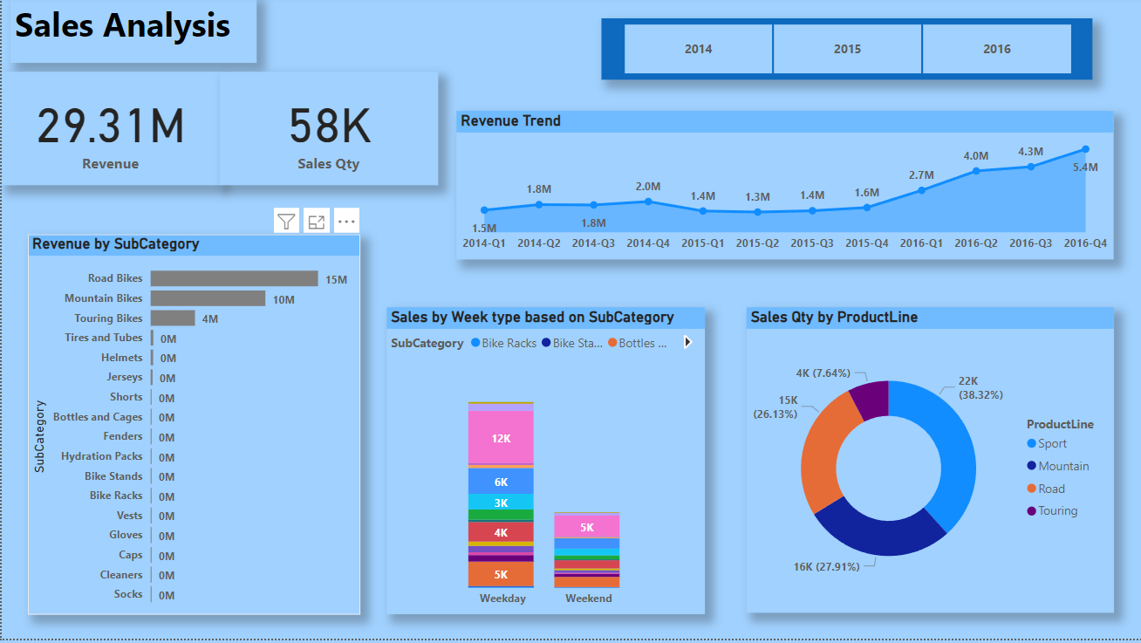
16 High Level Design
5.1 Power BI Report

Slide 18
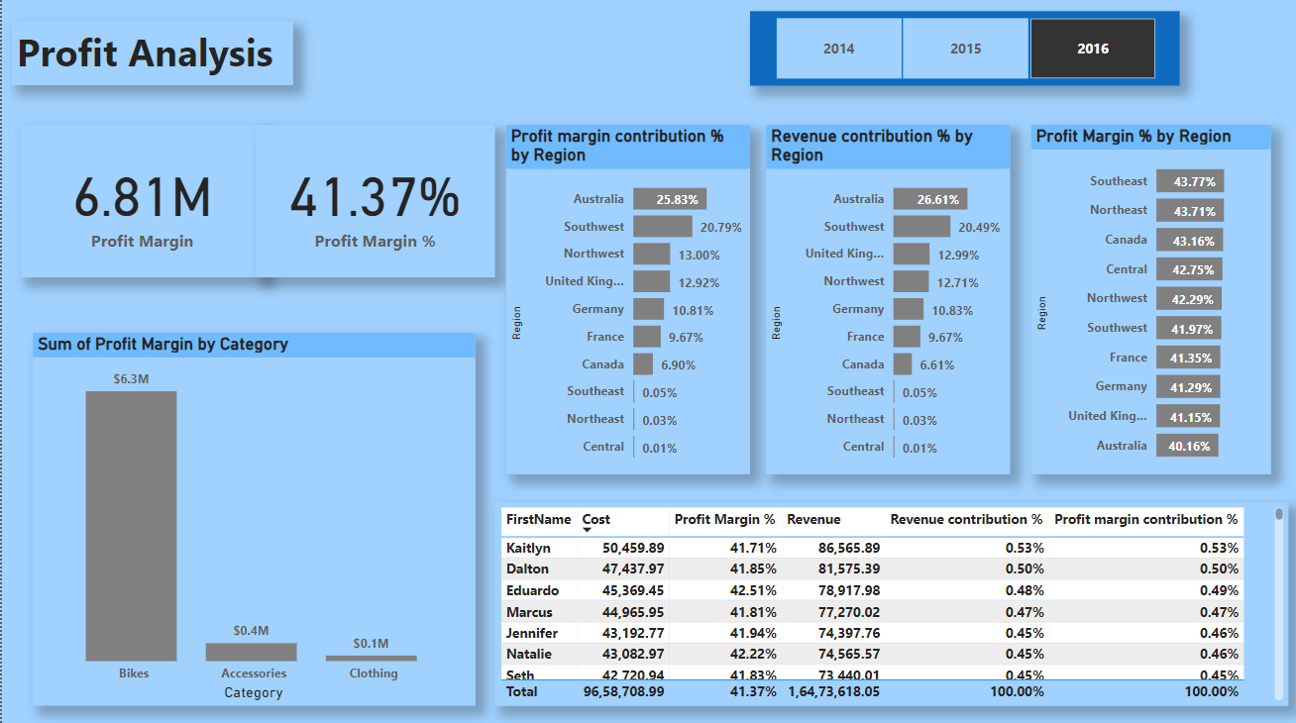
17 High Level Design

Slide 19
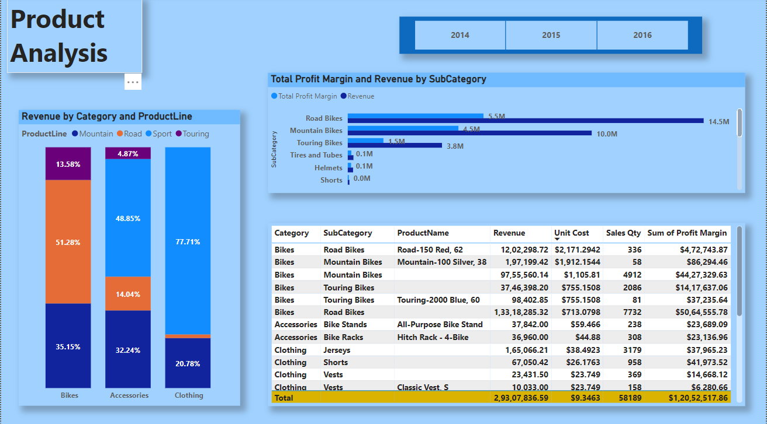
18 High Level Design

Slide 20
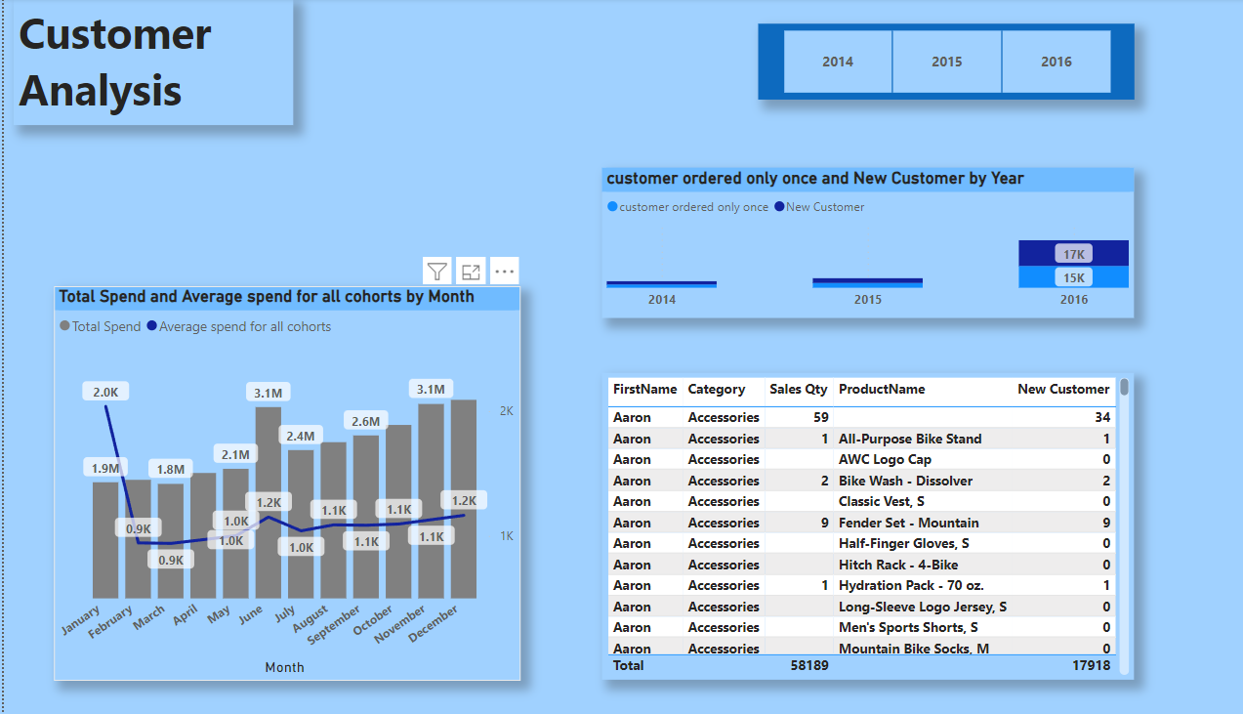
19 High Level Design

